Slide 1
Talent Share Portal
Mentors:
Shilpi Saha
` Vinay Kumar Singh
Bhavin Panchal
September 2023

Slide 2
Content
Introduction
Objectives
Technology Stack
Diagrams
Versioning Tool Used
Deployment Process
Challenges Faced
Summary
Q&A

Slide 3

Introduction
The purpose of this web application is to serve as a central portal for internal employees, providing them access to a platform where they can connect with mentors. Through this website, mentees can search for mentors based on their technical skills and interests.

Slide 4

Objective
To facilitate effective mentorship within the organization by providing a platform for mentees to find mentors based on technical skills and interests.
Based on matched skillset, mentee can apply for the mentorship with the respective mentor and get support to level up skills.

Slide 5

Technology Stack
The Technology stack:
Frontend and Backend with the 2 Microservices named Mentee and Mentor
Frontend - Angular with Bootstrap and Reactive Forms, Angular Material UI
Backend - Spring Boot with Restful Microservices, Junit5
Database – MongoDB & Libraries- Lombok

Slide 6

Functional Architecture Diagram
If not Registered, Please Sign Up as Mentee/Mentor
1.Me
Login
Mentor
Mentee
Search Mentor By Skills
View Profile/Mentor Details
Logout
Back to View Profile
Skill Matched
Show the list Of Mentors
true
false
No Mentor Found
Update Details
Delete Account
View Mentor
Reset Skills and search/Logout

Slide 7
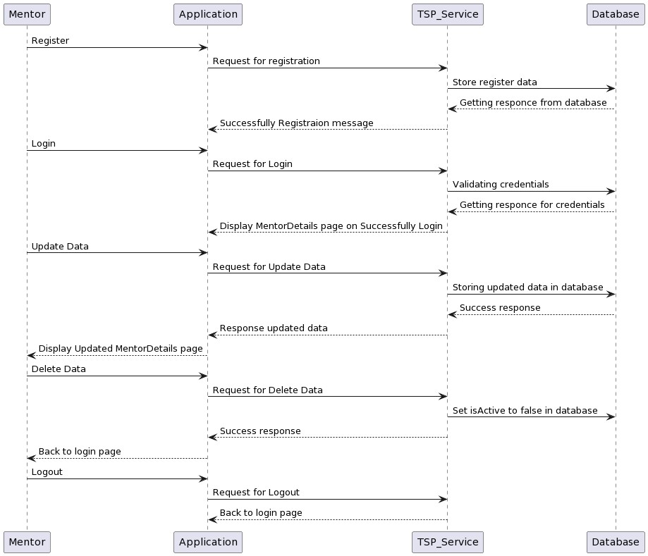
Sequence Diagram for Mentor

Slide 8
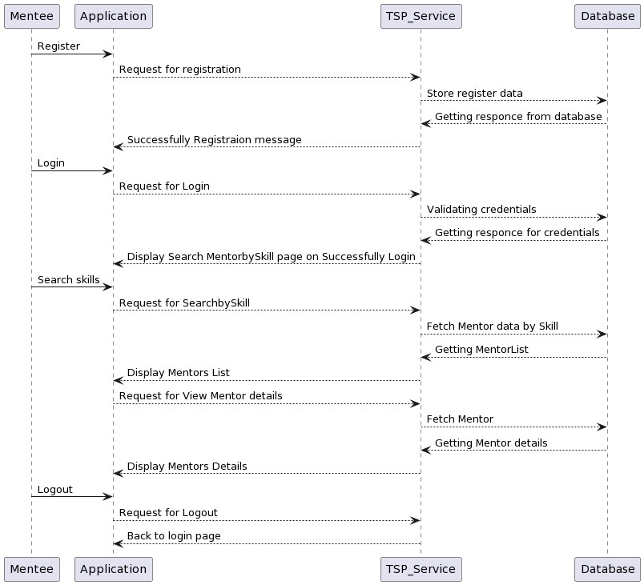
Sequence Diagram for Mentee

Slide 9
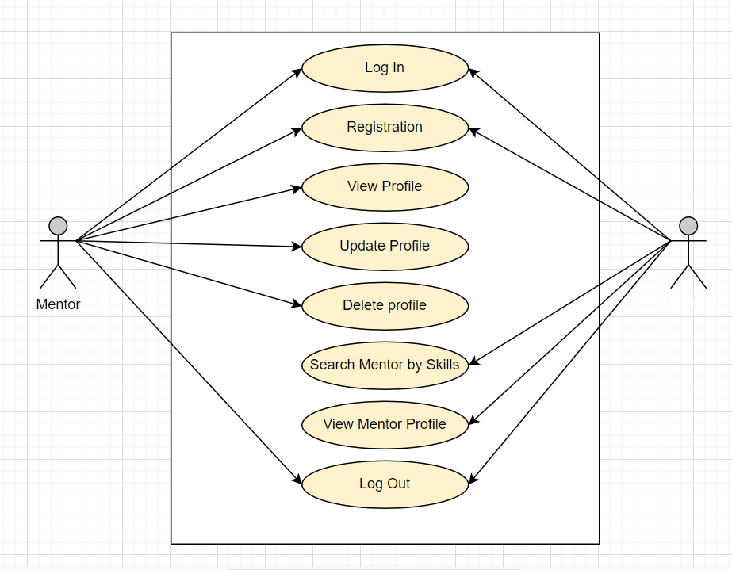
Use Case Diagram

Slide 10
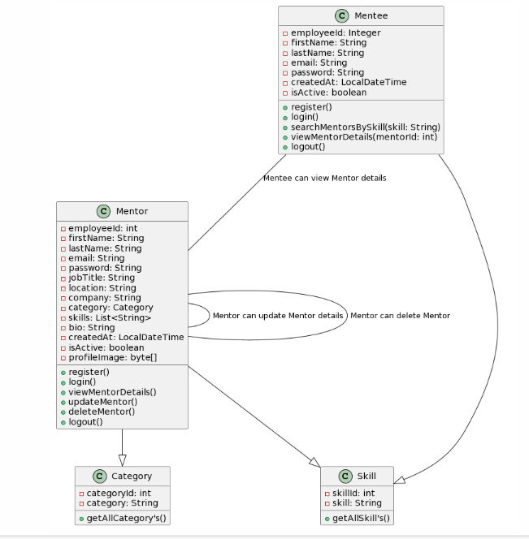
Class Diagram

Slide 11
Versioning Tool Used.
We have used GitLab as a versioning tool for our project so that project development can go with simple and smooth process.
We have Two repository
1) Talent share portal – Mentee (Backend)
2) Talent share portal – Mentor (Backend)
3) Talent share portal –Frontend.
Git Branch:-
•Main (or Master)
•Dev (Development)
•Feature branches (with individual names for specific features or tasks)

Slide 12
Deployment Process
Step 1: Pre-Deployment Tasks
Step 2: Angular Deployment
1. Build the Angular Application.
2. Web Server Configuration.
3. Environment Configuration.
Step 3: Spring Boot Deployment
    Build the Spring Boot Application
    Choose a Deployment Environment
    Database Configuration
    Deployment to the Chosen Environment
    Security Considerations

Slide 13
Challenges Faced
Backend-Frontend Integration Challenge:
  One of the significant challenges we encountered during the problem phase was related to the seamless integration between the Angular frontend and the Spring Boot backend, where ensuring smooth communication and data flow between these two components proved to be a complex task.
Adopting a New Technology Stack:
  In addition to the project's core challenges, we learned Angular for the frontend and Spring Boot for the backend while using these technologies to build and develop our project simultaneously, showcasing our dedication to continuous learning and improvement.

Slide 14
Summary
We have developed the System ‘Talent Share Portal’ where mentees can search mentors by skills and get the support from mentor to level up their skills which will enhance knowledge and gain the expertise in the specific area.
Provide the ease to the user to search and view details of mentor from one place.
Future scope- Book appointment and plan for mentorship option for mentee.

Slide 15

Question And Answers
Any Questions?

Slide 16


